Slide 1

Air Quality, Lora and Azure Functions
Making a useful connected device with Azure.
Rob Miles
www.robmiles.com

Slide 2
Overview
About Rob
Why make an air quality sensor?
Measuring air quality?
Building a device
Connecting a device using MQTT
The Azure IoT Hub and MQTT
Using Azure Functions with MQTT
LoRa and Azure

Slide 3
About Rob:
Taught Computer Science at Hull University for many years
In charge of twisting minds and crushing dreams
A Microsoft MVP
Blogs at: www.robmiles.com
Tweets at: @robmiles
Writes books…..

Slide 4
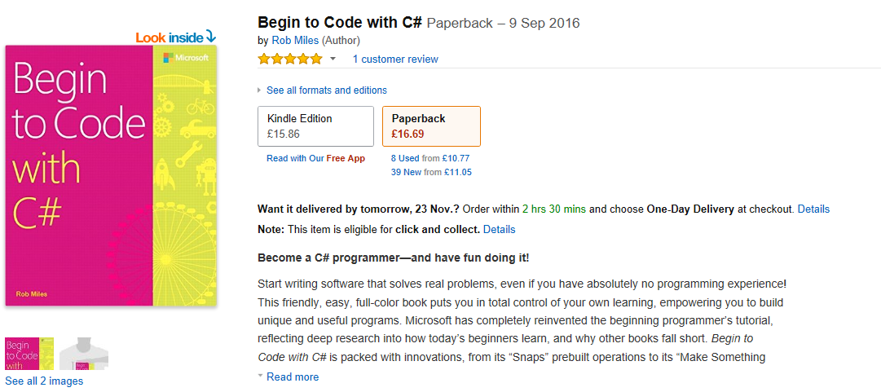
Begin to Code with C#

Slide 5
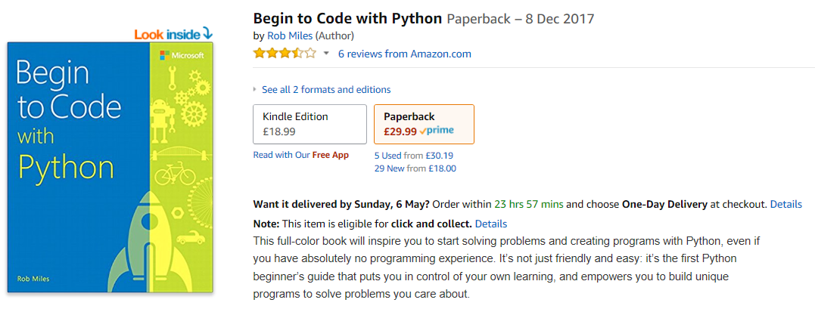
Begin to Code with Python

Slide 6
Why make an Air Quality Sensor?

Slide 7
How do we currently determine air quality?
The Met Office weather forecast and climate prediction model has been developed to include air quality forecasting in a new model configuration called AQUM.
Air quality is determined by the following factors:
Emissions of pollutants
Transport and dispersion of pollutants by winds
Chemical reactions amongst reactive gases and aerosols
Removal processes, such as rain and deposition on surfaces.
The Met Office model uses UK and European maps of annual average pollutant emissions to simulate the release of chemical species into the atmosphere.

Slide 8
Calculated readings
The thing to remember here is that a lot of these readings are created by the use of software models
There are some readings that are entered into the system, but these are few and far between
We thought it might be interesting to try and find out if we could use cheap air quality sensors to improve on the resolution of the readings and learn things about local air quality
It has turned out to be very interesting….

Slide 9
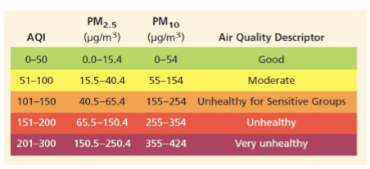
Good and bad air quality
This table shows the mapping between air quality values and what they mean for us
“Professional” sensors will also read the amount of Nitrogen Oxide and ozone
These sensors are quite expensive and so we thought we’d start with particles

Slide 10
Good and bad air quality
This table shows the mapping between air quality values and what they mean for us
“Professional” sensors will also read the amount of Nitrogen Oxide and ozone
These sensors are quite expensive and so we thought we’d start with particles

Slide 11
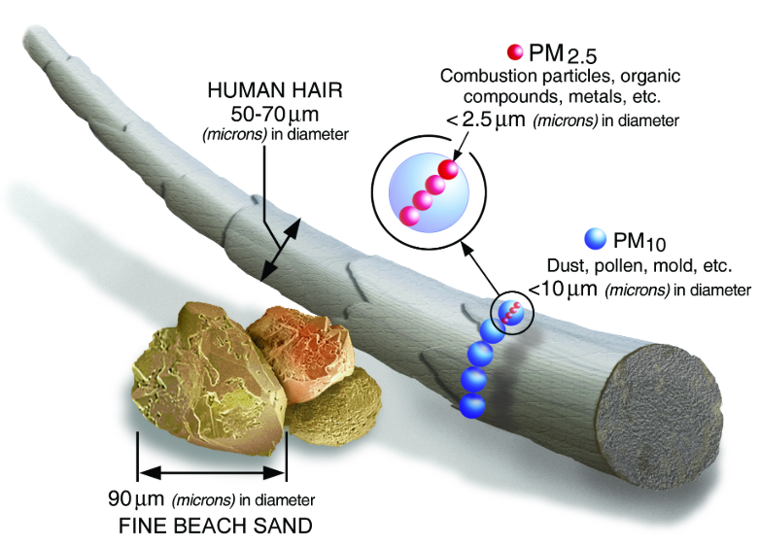
Measuring air quality
We decided to measure the density of smoke particles in the air
These are produced by vehicles and also by burning fossil fuels
The ones we are interested in have a radius of less than 2.5 microns
A micron is a millionth of a metre

Slide 12
Technology as an agent of change
I strongly believe that you can use technology to change the way that people behave, and to make things better
If we can make people better informed of the consequences of their actions we might be able to change what they do
Plastic bags and doggy poo are good examples of successes in this area
For example, if we end up producing evidence that a large number of vehicles at the school gates produces peaks in air pollution, perhaps people might not use their cars to take their kids to school quite so much

Slide 13
A General Note about projects
If you want to learn how to use a particular technology one of the best ways is to try and build something
Just learning stuff by reading books and watching YouTube videos does not work – you need to get making things
When you start building things you find out what the real problems are
We thought that the hard part of our project would be making the sensors
This turned out not to be the case, but more of that later……

Slide 14
Measuring Air Quality

Slide 15
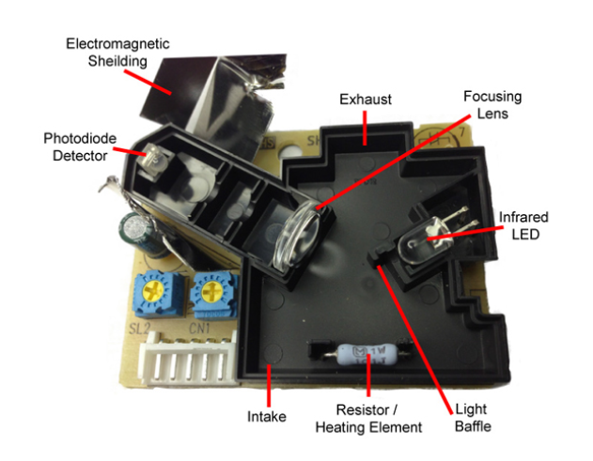
How a sensor works
The dust sensors work by shining a beam of light through the air and then detecting the light scattered by the particles in the air
The air can be moved by a fan, or by using a heater that causes convection
You can buy sensors that work like this for around 5 pounds

Slide 16
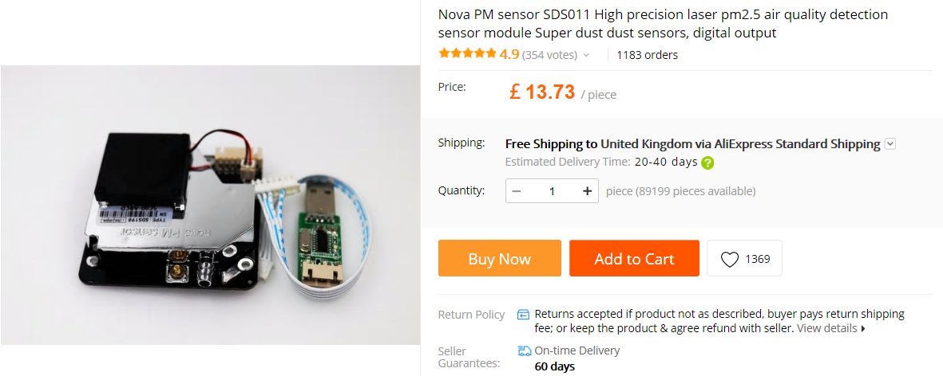
The sensor we like
This is the Nova SDS011 sensor
It has been used successfully on numerous air quality projects
Has a pipe connection for the inlet and a fan that moves the air
Can connect it to a PC or an embedded device

Slide 17
The meaning of the readings
These sensors are quite cheap
They are certainly not as accurate as the ones used by DEFRA
They are also susceptible to environmental factors
Increased humidity inflates their readings
Hard to be absolutely sure what they are reading
However, we think they can be useful in the context of establishing a base line and then detecting changes from this
DEFRA has guidance on how they can be used:
uk-air.defra.gov.uk/library/aqeg/pollution-sensors/how-could-I-use.php

Slide 18
Building a device

Slide 19
Building a sensor node device
A sensor node needs a micro-controller to get data from the sensor and send it into the server backend
It could do other things too, for example drive a display
Hardware for embedded devices is incredibly cheap
They are rather powerful
They can be programmed using Arduino platform
This provides a whole set of libraries and a development environment for embedded devices

Slide 20
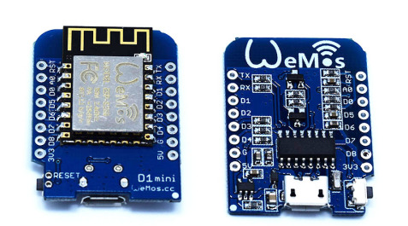
The esp8266 is an awesome chip….
Lots of WiFi options
WiFi client over a serial port
Fully programmable in C++ just like the Arduino
WiFi access point and web server
Support for UDP, TCP, secure sockets and mDNS
Very easy to use with many examples
Making a connected client device
Lots of ways to do this
We’re going to use MQTT but you can use it as a web server, or even a WiFi access point (or both)
I use the Wemos platform – around two pounds fifty a pop…

Slide 21
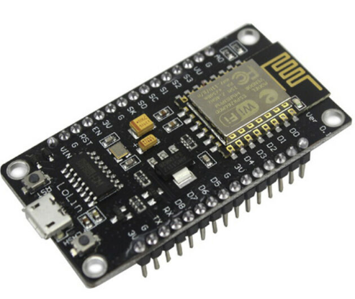
The ESP32 is even awesomer….
Very powerful processor:
Dual core, 16M of RAM, 240MHz clock
Program in C++ or Python
Three serial ports
Oodles of I/O
WiFi and Bluetooth BLE
Lots of WiFi options
WiFi client over a serial port
WiFi access point and web server
Support for UDP, TCP, secure sockets and mDNS
This is the DOIT ESP32 Devkit, which costs around a fiver

Slide 22
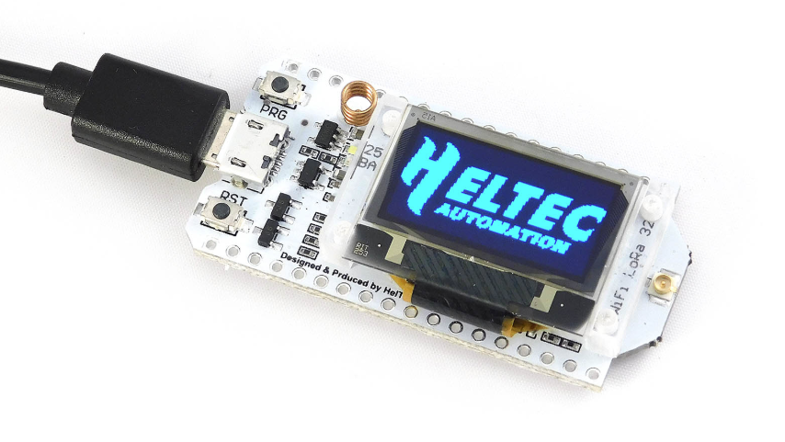
Heltec Platform
We really like the Heltec device
The Heltec version costs a bit more (15 pounds) but includes an OLED screen and a LoRa (Low powered Radio) device of which more later
heltec.org/project/wifi-lora-32/

Slide 23
Programming your connected hardware
Making your own connected hardware is cheap and fun
You can program an embedded device in a variety of languages
I like to use C++
The software is free and can be used from within Visual Studio and Visual Studio Code
The programming environment works with a variety of devices
There are pre-built libraries for lots of devices and services
You can also use MicroPython which runs on the device

Slide 24
The Monitair Sensor Node Firmware
The sensor has been designed to be used as a connected appliance
It can operate as a WiFi access point for network configuration

Slide 25
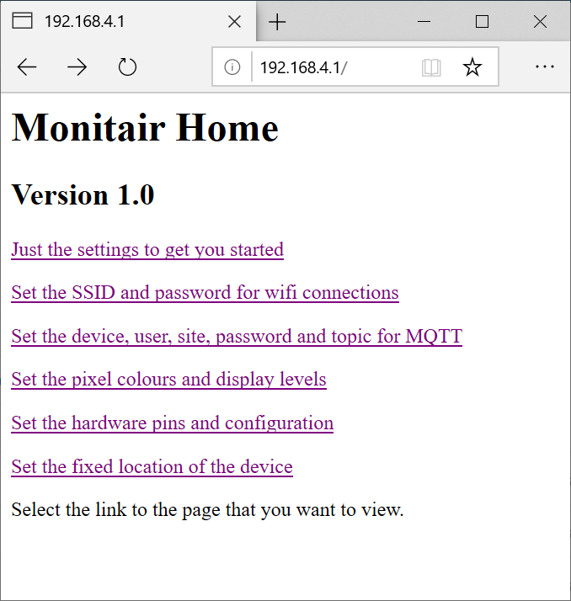
The Monitair Sensor Node Firmware
The sensor hosts a web page from which the user can configure WiFi and MQTT settings

Slide 26
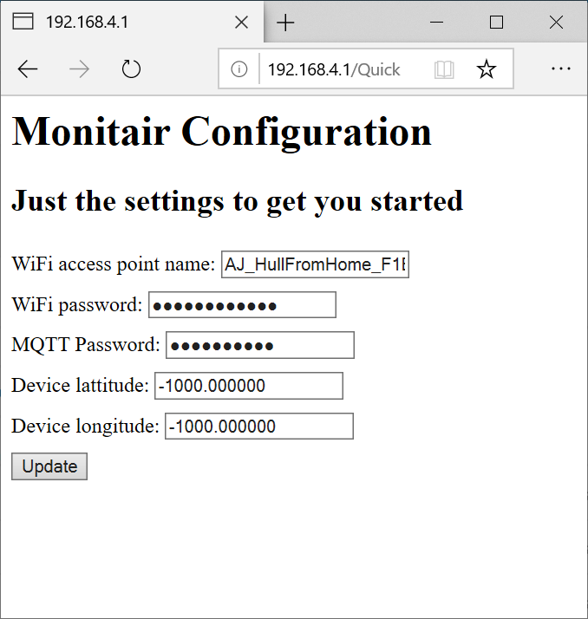
The Monitair Sensor Node Firmware
There is also a “quick configuration” page for popular settings

Slide 27
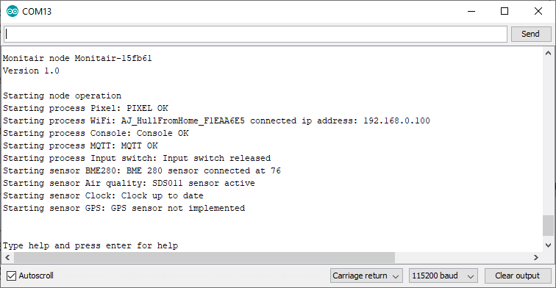
The Monitair Sensor Node Firmware
..as well as a serial interface for factory configuration and testing

Slide 28
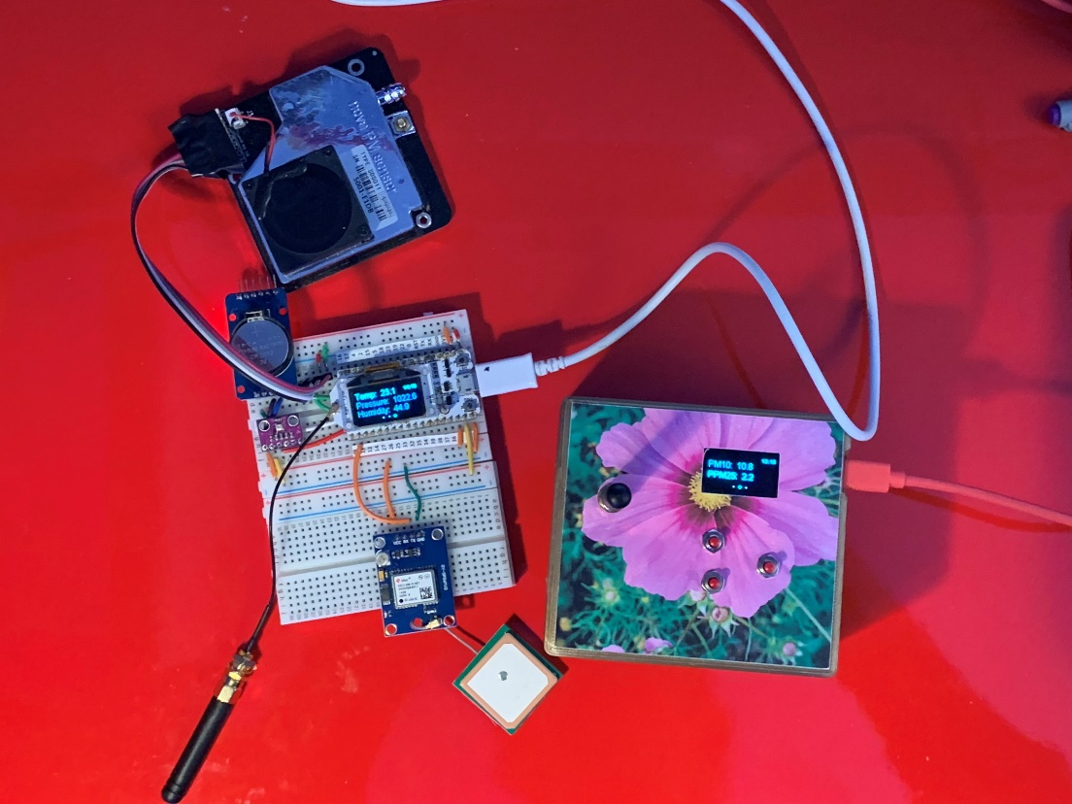
My first sensor
This is my first “proper” sensor in “breadboard” and finished versions
It measures temperature, pressure, humidity and particle density
The readings can be sent over MQTT or LoRa to a server
It can be configured using strings of JSON that can be sent over MQTT, serial connection or LoRa
It also has a GPS receiver to tag readings with their location

Slide 29
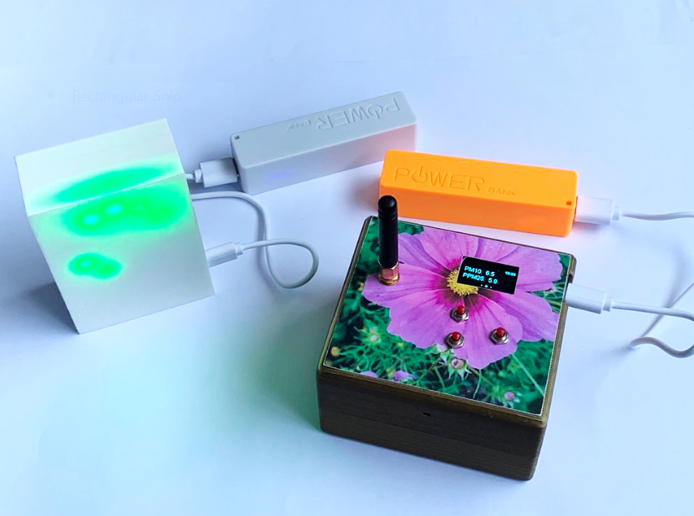
My products
I now have a few sensor designs
One can also be used as a remote visualizer
This can connect to a data source and display air quality or any other data

Slide 30
Connecting a device using MQTT

Slide 31
IoT device connectivity
The devices that we have looked at all have WiFi
You can use them to create network connections so they can use datagrams or connections
They will work as web servers
They can also support secure sockets
You can connect to network services using restful connections
However, the IoT community makes a lot of use of MQTT (Message Queue Telemetry Transport)
This is a very easy way to hook sensors and actuators together

Slide 32
Message Queue Telemetry Transport
MQTT is a way to connecting sensors to endpoints
It has a publish/subscribe architecture
The communication can run over serial or WiFi and is based on a simple packet structure
People have different opinions of how good it is, but it is very popular and also supported by the Azure IOT Hub
It also runs (surprise surprise) on the esp8266
It is a great way to create cheap, connected, sensors

Slide 33
The MQTT broker
MQTT Broker
Sensor Node
Data Collector
Publish
Subscribe
The MQTT broker accepts messages and passes them on to subscribers that have registered as listening to an endpoint topic
Sensor nodes can subscribe to topics so that they can be sent commands
MQTT messages are just blocks of bytes
We encode them into JSON strings

Slide 34
Connecting Arduino devices to MQTT
I use PubSubClient for Arduino devices
You can add it to your Arduino solution as you would any other library
It works well on the ESP8266 and ESP32 devices
It can talk to any MQTT broker, including Azure the one provided by Azure IoT Hub (as long as you use secure sockets for the connection)
There is also a Microsoft client you can add to an Arduino project

Slide 35
Connecting to an MQTT broker
mqttPubSubClient->setServer(settings.mqttServer, settings.mqttPort);
mqttPubSubClient->setCallback(callback);
mqttPubSubClient->connect(settings.deviceName, settings.mqttUser,
settings.mqttPassword);
Setting up an MQTT client is simple enough
We need some configuration information that identifies the device to the broker

Slide 36
Set the server
mqttPubSubClient->setServer(settings.mqttServer, settings.mqttPort);
mqttPubSubClient->setCallback(callback);
mqttPubSubClient->connect(settings.deviceName, settings.mqttUser,
settings.mqttPassword);
This statement sets up the server
The mqttServer element is the network address of the server
The mqttport is the TCPIP port to be used
Open data 1883
Secure Sockets 8883

Slide 37
Assign a function for callbacks
mqttPubSubClient->setServer(settings.mqttServer, settings.mqttPort);
mqttPubSubClient->setCallback(callback);
mqttPubSubClient->connect(settings.deviceName, settings.mqttUser,
settings.mqttPassword);
This statement identifies the function to be called when the broker sends an MQTT message to a topic the device has subscribed to
Our application must contain a function called callback
This is how we can use MQTT to control a device

Slide 38
Connect the device
mqttPubSubClient->setServer(settings.mqttServer, settings.mqttPort);
mqttPubSubClient->setCallback(callback);
mqttPubSubClient->connect(settings.deviceName, settings.mqttUser,
settings.mqttPassword);
This call actually makes the connection
The device name is the MQTT device name
On a standard MQTT broker the mqttUser is the username for the broker and the mqttPassword is the password
This is not particularly secure – anyone with the broker username and password can add their own devices and subscribe to endpoints

Slide 39
Sending MQTT Messages
mqttPubSubClient->publish("airquality/data", buffer);
A message is a string of bytes which is published on a given topic
Topics are hierarchical and can contain wildcards which allow a subscriber to receive from collections of sources

Slide 40
Receiving MQTT Messages
mqttPubSubClient->subscribe(settings.mqttSubscribeTopic);
The node can nominate a topic which it is interested in
The broker will relay messages sent to that topic onto that node
This will cause the callback function to be called each time a message for that topic arrives

Slide 41
Keeping the MQTT connection alive
mqttPubSubClient->loop();
MQTT clients send a message every 9 seconds to keep the MQTT connection alive
The node must make regular calls to the loop method in the MQTT connection object to check for incoming messages and send the heartbeat message
This is how the broker determines which clients are connected

Slide 42
MQTT housekeeping
There are a number of different Quality of Service (QoS) levels
QoS 0 – the message is sent once and will be received once or never (like a datagram)
QoS 1 – the message will be delivered at least once (sender waits for an acknowledgement and resends if one is not received)
QoS 2 – the message will be delivered exactly once
Azure IoT hub uses QoS level 2
Stations can nominate a “last wishes” message to be sent to subscribers if their connection is lost

Slide 43
MQTT Resources
I use PubSubClient for the Arduino based sensor nodes
Install it as any other Arduino library
Eclipse Paho has MQTT software for a wide range of platforms
https://www.eclipse.org/paho/
If you want to run your own MQTT broker (perhaps for a home network) take a look at Mosquitto
https://mosquitto.org/
The NodeRed tool is a great way to create flows of data between devices
https://nodered.org/

Slide 44
The Azure IoT Hub and MQTT

Slide 45
Azure, MQTT and embedded devices
Azure IoT Hub provides a complete IoT device management framework
This includes device management and simulation
Devices can be created and managed securely and programmatically
You can use it to create “proper” IoT device networks
Azure and MQTT
The Azure IoT Hub will interact with MQTT messages
These can be passed on to your backend Azure applications and Azure applications can also be sent to MQTT devices

Slide 46
The Azure IoT Hub
Azure IoT Hub
Sensor Node
Everything Azure
Publish
Service Bus
MQTT enabled devices can connect to Azure IoT hub, publish messages and subscribe to topics
The received messages then allow you to do lots of lovely things with your connected devices
There is also a lot of device management support too
… and it is all done over secure channels

Slide 47
Connecting to MQTT – Azure Iot Hub
mqttPubSubClient->setServer(settings.mqttServer, settings.mqttPort);
mqttPubSubClient->setCallback(callback);
mqttPubSubClient->connect(settings.deviceName, settings.mqttUser,
settings.mqttPassword);
mqttServer – address of server
mqttPort – 8883 (secure sockets only)
deviceName – name of the device
mqttUser – unique username for device
mqttPassword – Shared Access Signature (SAS) key for the device

Slide 48
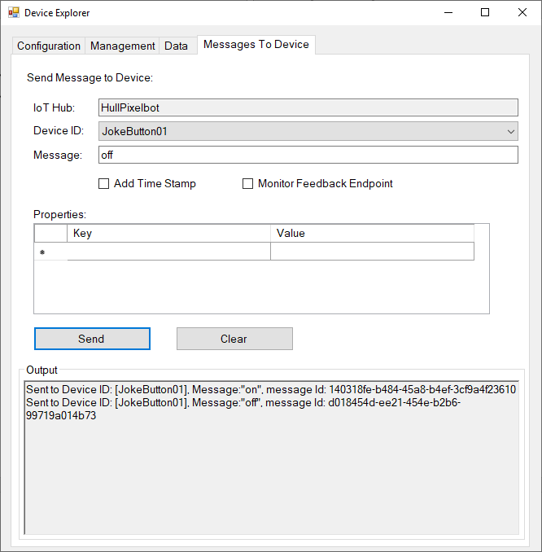
Device Explorer
The device explorer provides device management and testing
This is available in source form
We can view messages from connected clients and send messages to them as well
This is not the only way to provision devices
There is also an api you can use to build a workflow if you have lots of devices

Slide 49
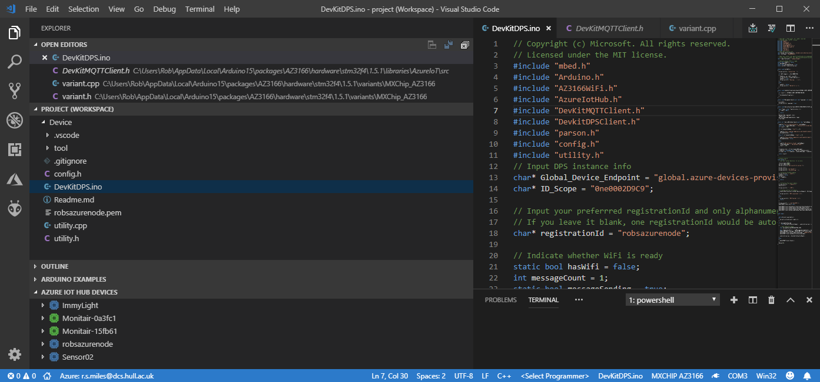
Visual Studio Code
Visual Studio Code is a great place to create solutions
You can register and monitor devices on the Azure IoT Hub

Slide 50
Using Azure Functions and MQTT

Slide 51

Azure Functions
An Azure Function is a lump of code that runs in the cloud when an event occurs
As a developer you just have to create the code and deploy it into Azure
There is no need to create a server
You only pay for the time your function is active, not the time that your server is running

Slide 52
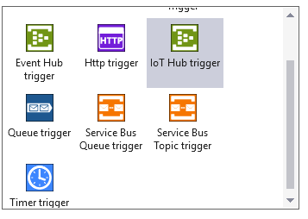
Azure Functions Events
You can fire off an Azure function on a variety of trigger events including web requests and timed events
We are going to trigger the function when an incoming message is received from a node
The function will store the incoming value in Azure Table Storage

Slide 53
Azure Table Storage
To keep thing simple I’m going to store the readings in Azure Table Storage
This stores each reading as a row in a table
Rows are defined by mapping a POCO (Plain Old CLR Object) value
In my case I’m creating an instance of a C# class
The instance must have two members used to index the table:
PartitionKey – broad categorisation of the data
RowKey – unique value for any given PartitionKey value

Slide 54
My Air Quality Reading
{ "dev":"Monitair-15fb61","temp":24.73,"humidity":41.33,
"pressure":1017.30,"PM10":13.00,"PM25":5.10,"timestamp":"1551432371"}
This is the MQTT message that is sent by the sensor node to the server
It is formatted using JSON
This needs to be stored on the server

Slide 55
My Air Quality Class
public class AirQReading
{
[JsonProperty("dev")]
public string PartitionKey { get; set; }
[JsonProperty("timestamp")]
public string RowKey { get; set; }
public float PM10 { get; set; }
public float PM25 { get; set; }
[JsonProperty("temp")]
public float Temp { get; set; }
[JsonProperty("humidity")]
public float Humidity { get; set; }
[JsonProperty("pressure")]
public float AirPress { get; set; }
}
The device property is mapped onto the PartitionKey
The time property is mapped onto the RowKey

Slide 56
My Azure Function
[FunctionName("DataReceiver")]
[return: Table("AirQualityReadings")]
public static AirQReading Run([IoTHubTrigger("devices/#", Connection = "IoTHubConnectionString")]EventData message, TraceWriter log)
{
string readingJson = Encoding.UTF8.GetString(message.GetBytes());
AirQReading result = new AirQReading();
JsonConvert.PopulateObject(readingJson, result);
return result;
}
This is the function that receives data and store it in the table

Slide 57
My Azure Function
[FunctionName("DataReceiver")]
[return: Table("AirQualityReadings")]
public static AirQReading Run([IoTHubTrigger("devices/#", Connection = "IoTHubConnectionString")]EventData message, TraceWriter log)
{
string readingJson = Encoding.UTF8.GetString(message.GetBytes());
AirQReading result = new AirQReading();
JsonConvert.PopulateObject(readingJson, result);
return result;
}
This is the name of the function

Slide 58
My Azure Function
[FunctionName("DataReceiver")]
[return: Table("AirQualityReadings")]
public static AirQReading Run([IoTHubTrigger("devices/#", Connection = "IoTHubConnectionString")]EventData message, TraceWriter log)
{
string readingJson = Encoding.UTF8.GetString(message.GetBytes());
AirQReading result = new AirQReading();
JsonConvert.PopulateObject(readingJson, result);
return result;
}
Identifies the table into which the readings will be placed
The storage connection string is given in the settings for the project

Slide 59
My Azure Function
[FunctionName("DataReceiver")]
[return: Table("AirQualityReadings")]
public static AirQReading Run([IoTHubTrigger("devices/#", Connection = "IoTHubConnectionString")]EventData message, TraceWriter log)
{
string readingJson = Encoding.UTF8.GetString(message.GetBytes());
AirQReading result = new AirQReading();
JsonConvert.PopulateObject(readingJson, result);
return result;
}
This is the MQTT topic to be monitored
This monitors messages from all devices (# is a wildcard)

Slide 60
My Azure Function
[FunctionName("DataReceiver")]
[return: Table("AirQualityReadings")]
public static AirQReading Run([IoTHubTrigger("devices/#", Connection = "IoTHubConnectionString")]EventData message, TraceWriter log)
{
string readingJson = Encoding.UTF8.GetString(message.GetBytes());
AirQReading result = new AirQReading();
JsonConvert.PopulateObject(readingJson, result);
return result;
}
This maps to an SAS connection string held in the function settings file
You need to copy this setting to your function when you deploy it

Slide 61
My Azure Function
[FunctionName("DataReceiver")]
[return: Table("AirQualityReadings")]
public static AirQReading Run([IoTHubTrigger("devices/#", Connection = "IoTHubConnectionString")]EventData message, TraceWriter log)
{
string readingJson = Encoding.UTF8.GetString(message.GetBytes());
AirQReading result = new AirQReading();
JsonConvert.PopulateObject(readingJson, result);
return result;
}
This is the message instance that will be delivered into the function call by Azure IoT hub

Slide 62
My Azure Function
[FunctionName("DataReceiver")]
[return: Table("AirQualityReadings")]
public static AirQReading Run([IoTHubTrigger("devices/#", Connection = "IoTHubConnectionString")]EventData message, TraceWriter log)
{
string readingJson = Encoding.UTF8.GetString(message.GetBytes());
AirQReading result = new AirQReading();
JsonConvert.PopulateObject(readingJson, result);
return result;
}
The function can write messages into this log

Slide 63
My Azure Function
[FunctionName("DataReceiver")]
[return: Table("AirQualityReadings")]
public static AirQReading Run([IoTHubTrigger("devices/#", Connection = "IoTHubConnectionString")]EventData message, TraceWriter log)
{
string readingJson = Encoding.UTF8.GetString(message.GetBytes());
AirQReading result = new AirQReading();
JsonConvert.PopulateObject(readingJson, result);
return result;
}
Convert the message payload into a string

Slide 64
My Azure Function
[FunctionName("DataReceiver")]
[return: Table("AirQualityReadings")]
public static AirQReading Run([IoTHubTrigger("devices/#", Connection = "IoTHubConnectionString")]EventData message, TraceWriter log)
{
string readingJson = Encoding.UTF8.GetString(message.GetBytes());
AirQReading result = new AirQReading();
JsonConvert.PopulateObject(readingJson, result);
return result;
}
Create an empty AirQReading instance

Slide 65
My Azure Function
[FunctionName("DataReceiver")]
[return: Table("AirQualityReadings")]
public static AirQReading Run([IoTHubTrigger("devices/#", Connection = "IoTHubConnectionString")]EventData message, TraceWriter log)
{
string readingJson = Encoding.UTF8.GetString(message.GetBytes());
AirQReading result = new AirQReading();
JsonConvert.PopulateObject(readingJson, result);
return result;
}
Populate the AirQReading instance with values from the received JSON string (missing values are left at default values)

Slide 66
My Azure Function
[FunctionName("DataReceiver")]
[return: Table("AirQualityReadings")]
public static AirQReading Run([IoTHubTrigger("devices/#", Connection = "IoTHubConnectionString")]EventData message, TraceWriter log)
{
string readingJson = Encoding.UTF8.GetString(message.GetBytes());
AirQReading result = new AirQReading();
JsonConvert.PopulateObject(readingJson, result);
return result;
}
Return the POCO object that will be stored in the table

Slide 67
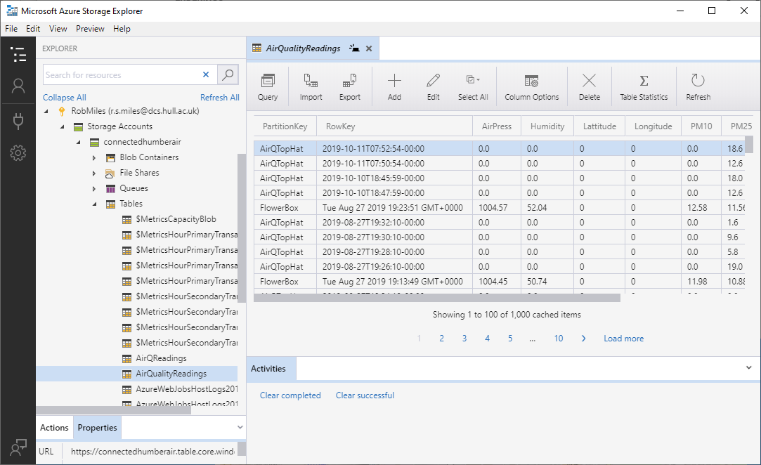
Azure Storage Explorer
You can use Azure Storage Explorer to view the received data

Slide 68
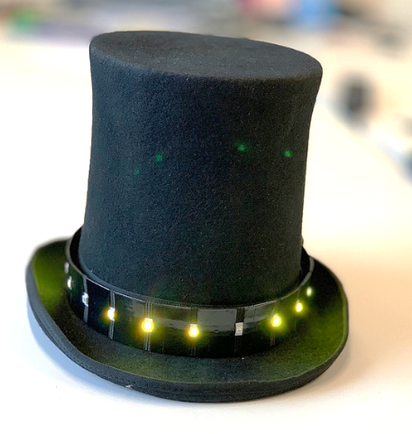
The Air Quality Top Hat
I built the Monitair software into a top hat
It uses a ZPHO1 sensor and a Wemos processor
This is not very reliable
But it only costs around a fiver
The hat uses neopixels to show the air quality around the wearer

Slide 69
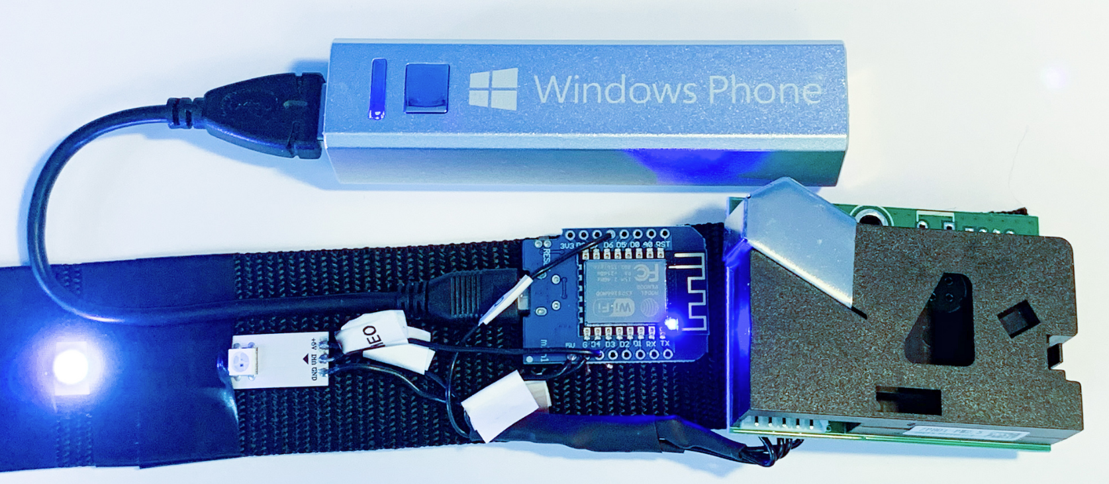
The Air Quality Top Hat
I built the Monitair software into a top hat
It uses a ZPHO1 sensor
This is not very reliable
But it only costs around a fiver
The hat uses neopixels to show the air quality around the wearer
The Wemos and the sensor are attached to a hatband
The Top Hat talks to Azure….

Slide 70
Demo
An Azure connected Air Quality top hat
Notes:
Start the Azure Function project
Connect the top hat to the PC via USB
Open a terminal connection to the hat
Open the serial monitor and watch the hat start up. Make sure that it is connected to the WiFi and MQTT service
Start the Azure Function running.
Use the send command on the hat to force an MQTT send.
Watch the function fire.
Open Azure Storage Explorer and show the stored data.

Slide 71
LoRa and Azure

Slide 72
What is LoRa?
Low Powered Radio
Long Range

Slide 73
Low powered radio
Designed for use in battery powered devices
Battery life measured in years
LoRa radio transmitters are cheap and easy to add to a device
Uses “Spread Spectrum Technology”
Messages are sent “below the noise” as packets of data
Best regarded as a form of “SMS” message rather than a continuous telephone call
There are limits on the message size and the number of messages you can send in a given time

Slide 74
Long Range
Range up to 15-20 km
(although this depends a lot on conditions – take it with a pinch of salt)
Lora wavebands
868 MHz for Europe
915 MHz for North America
433 MHz band for Asia
You don’t need a licence to use the LoRa band
But you should be using properly certified devices and not breach the usage conditions – if you’re doing this properly

Slide 75
LoRa “peer to peer” connection
You can use LoRa to connect two devices together
Think of this as a car remote keyfob with a really long range
Messages sent by one LoRa device will be received by the any other LoRa device that is listening
You would need to devise your own station addressing scheme
You may also need to add security in the form of packet encryption and verification

Slide 76
LoRaWan
You can also use a LoRa device as part of a larger network
A LoRa embedded device (an endpoint) will be associated with a given LoRa application
Within an application each LoRa device has a unique address
If you were making a “cow tracker” you’d attach an endpoint to the cow
Data between the endpoint and the gateway is encrypted
A LoRa gateway forwards all endpoint messages to a LoRa server
The server sends messages onto backend applications
This forms a LoraWAN (LoRa Wide-Area Network)

Slide 77
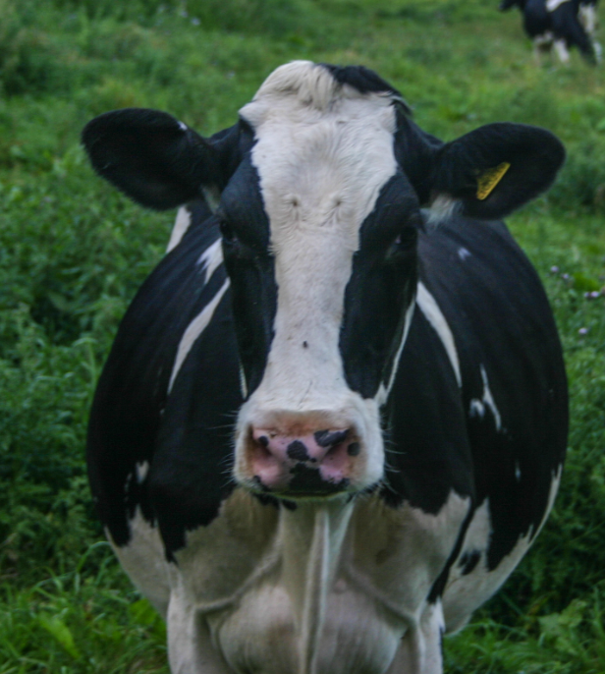
LoRaWAN cow tracking
Fit cows with LoRa endpoint devices that contain a GPS tracker and a LoRa wireless transmitter
Devices send location information every few hours
endpoints

Slide 78
LoRaWAN cow tracking
Endpoints send messages to a LoRa Gateway
LoRa Gateway
endpoints

Slide 79
LoRaWAN cow tracking
LoRa Gateway forwards messages to the LoRa Server
LoRa Gateway
LoRa Server
endpoints
network connection

Slide 80
LoRaWAN cow tracking
LoRa Server sends messages to your backend applications
LoRa Gateway
LoRa Server
Backend Server
endpoints
network connection
network connection

Slide 81
LoRaWAN cow tracking
The Lora server manages multiple message from different gateways
An incoming message is tagged with all the gateways that received it
LoRa Gateway
LoRa Gateway
LoRa Server
Backend Server
endpoints
network connection
network connection

Slide 82
What is a gateway?
A gateway has a LoRa radio receiver and a network connection
Receives messages from the endpoint and forwards them to a LoRa server
You can use LoRa endpoint devices as primitive gateways
But they don’t expose the full functionality as they are only single channel devices
The cheapest “proper” LoRa gateway is around 120 pounds and runs on a Raspberry Pi
Best placed high up and outdoors

Slide 83
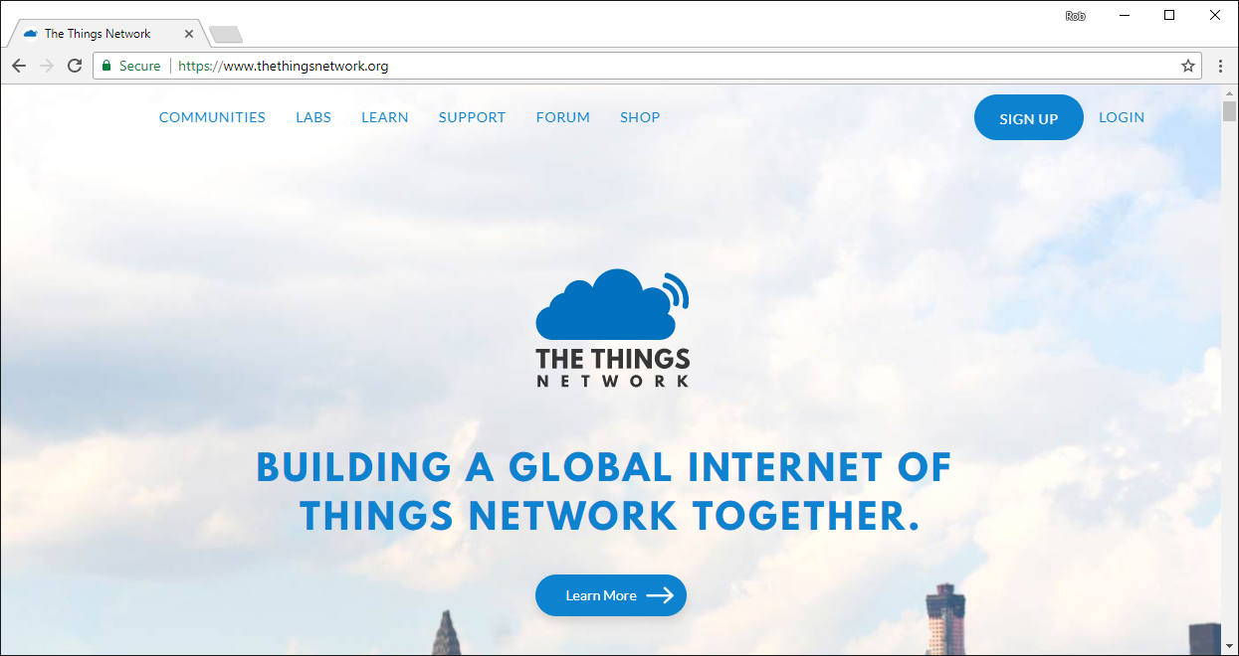
The Things Network
The Things Network underpins a worldwide network of open LoRa gateways

Slide 84
The Things Network
Building networked communities using LoRa
Provides the server backend for LoRaWAN applications
Creates open source software and hardware which you can use to build your own bespoke LoRa network
Sells LoRa devices on Kickstarter
You can buy your own gateway and register it on The Things Network
Any LoRa endpoint can then use your gateway as a conduit onto The Things Network
The Things Network will host your LoRa applications and pass your endpoint data into your own backend servers

Slide 85
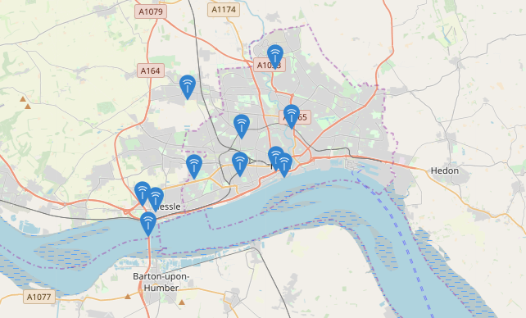
LoRa gateways in Hull
There are a number of gateways in Hull which are attached to The Things Network
We are trying to get more of them installed

Slide 86
What is a server?
The LoRa server receives messages from the gateways, identifies ones that are for applications it knows about, sorts out multiple messages and then forwards them on to the application backend
You can create your own servers, but for testing you can use those provided by The Things Network (TTN) for free
You can register your gateways on The Things Network and then create your applications and connect your servers to them
A great way to get started, but for “proper” services you would want to have your own infrastructure

Slide 87
LoRa Security
Because LoRa is a broadcast medium using public frequency bands anyone can eavesdrop on any message
An endpoint is associated with a particular application which is identified in each LoRa packet that the endpoint sends
Each application has an encryption key
Keys can be “baked in” to a device or deployed via the LoRa network
In addition, a given network session is encrypted by means of a network session key
Based on AES-128 (802.15.4 security)

Slide 88
Endpoint activation
No such thing as “default password” for a LoRa device
An endpoint must be activated before it can be used on a LoRa network
Two forms of activation:
Activation By Personalisation (ABP):
Credentials are “burned in” to the endpoint before it is deployed
Over The Air Activation (OTAA):
Endpoint is deployed containing an Application Root Key which is used to authenticate a setup process that produces credentials to be stored in the endpoint

Slide 89
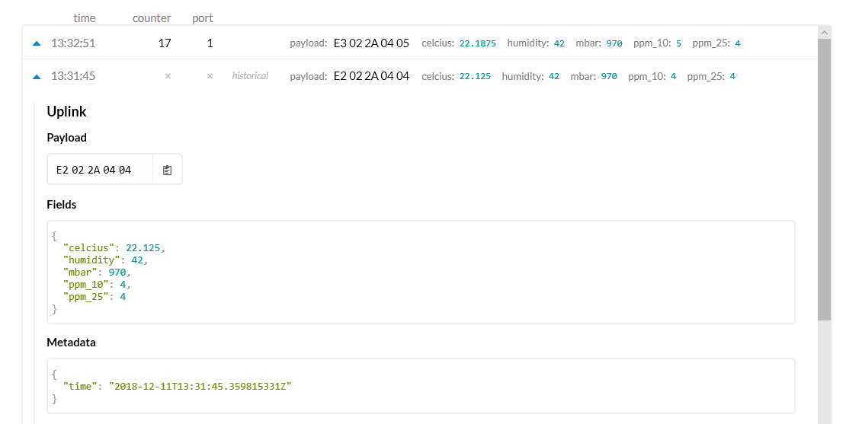
Application data
These are packets received from an endpoint
The data values are encoded at the node and decoded on receipt

Slide 90
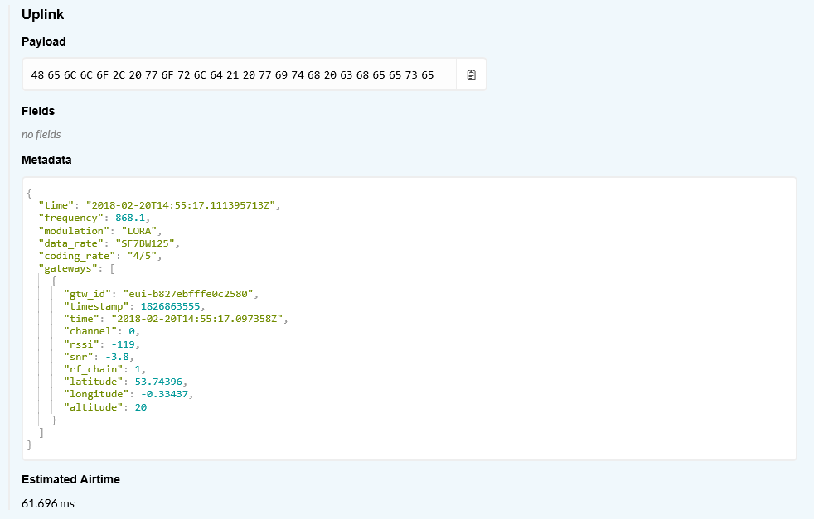
Application metadata
This is the metadata that gets also gets pushed up to the application
It contains details of the gateways that received the packet

Slide 91
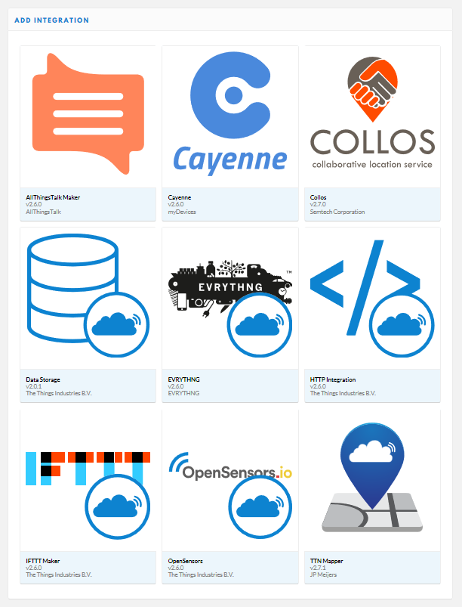
Integrations
The Things Network provides a set of “integrations” that you use to send LoRa messages into your application
You can use http GET/POST, or MQTT or IFTT
They also provide a database for short term storage (7 days)

Slide 92
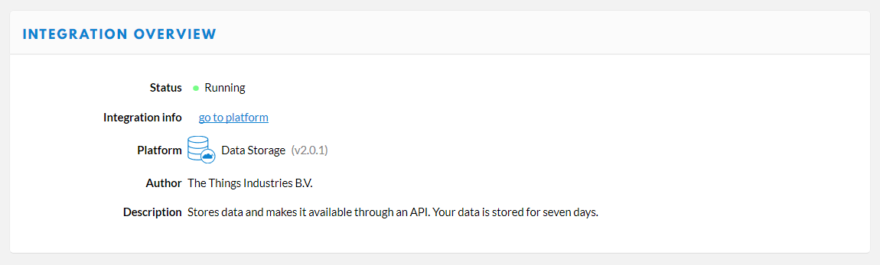
Data Storage
This integration will store your data for 7 days
There is a restful interface for getting readings back

Slide 93
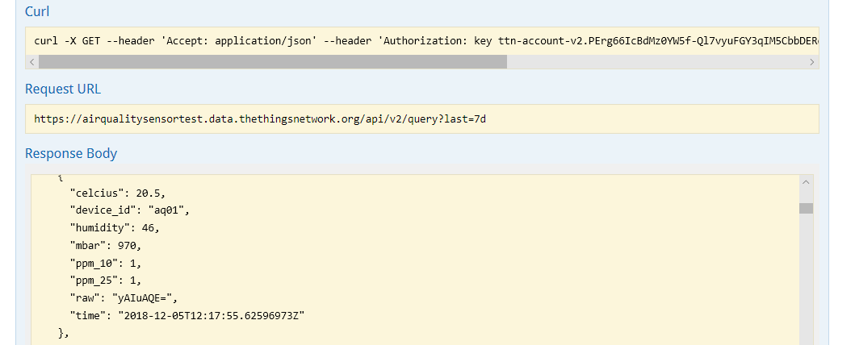
Reading back data
It is easy to pull data back from the Things Network
The API is defined by Swagger

Slide 94
Sending messages to a LoRa endpoint
A LoRa endpoint will not normally be listening for messages from the gateway
This is to save power
Class A
Listen for a brief interval after the endpoint has sent something
Class B
Listen for a brief interval at scheduled times
Class C
Nearly continuous listening (not suitable for battery powered endpoints)

Slide 95
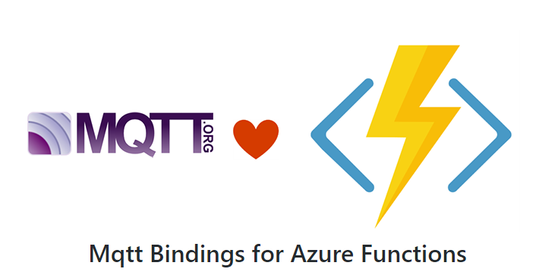
LoRa to Azure IoT
The Azure IoT Hub works with MQTT
Remote devices can publish and subscribe to topics it exposes
However, you need something extra to connect Azure IoT Hub to an MQTT broker
You need this because The Things Network acts as an MQTT broker to expose LoRa messages to clients
There are some MQTT bindings for Azure Functions:
https://github.com/keesschollaart81/CaseOnline.Azure.WebJobs.Extensions.Mqtt
You could also use a timed Azure Function to download batches of data

Slide 96
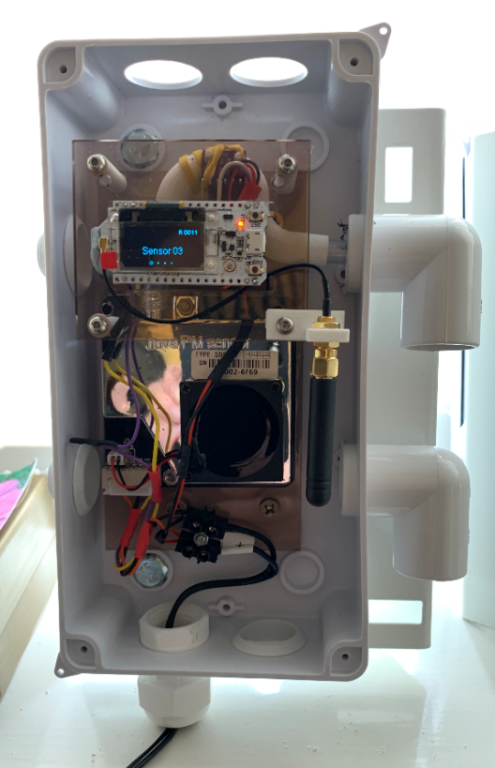
Lamp post sensors
We’ve built some sensors that fit on lamp posts
We want to compare our results with the professional sensors
It turns out that making something and fitting it on a lamp post is actually quite hard
The sensors have been running for about five months now

Slide 97
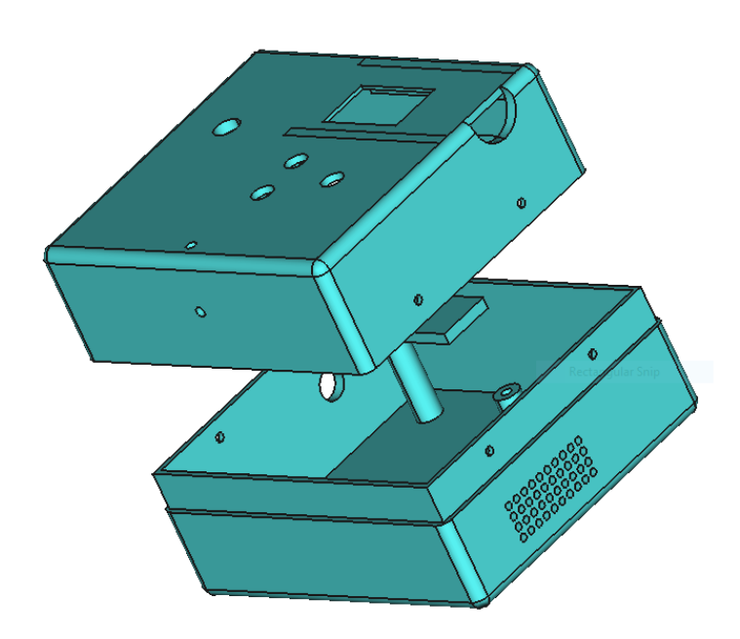
All on GitHub
All my sensor designs are on GitHub
This includes code and 3D printable files for the cases
These devices would serve as the basis of any remote controlled sensor or actuator
github.com/CrazyRobMiles/AirQuality

Slide 98

Connected Humber
Connected Humber is a community interest company (CIC) which was formed to promote technology in the Humber Region
We are building STEM materials and prototype devices for use in the community
We meet up at c4di in Hull on the first and third Thu. of each month
www.connectedhumber.org
mattermost.connectedhumber.org

Slide 99
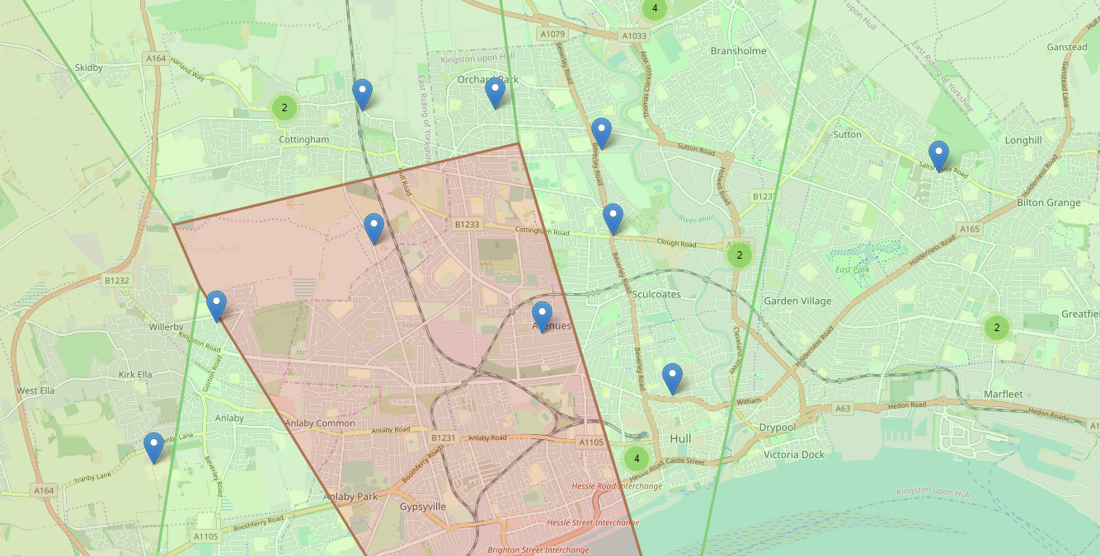
sensors.connectedhumber.org

Slide 100
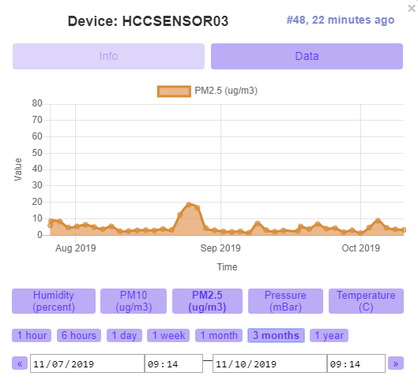
sensors.connectedhumber.org

Slide 101
Summary
Building connected devices is easy and cheap
The Azure IoT provides industrial strength support for MQTT connected devices
You can use Azure Functions to bind to events generated by devices
You can use Azure Table Storage to hold incoming data
LoRa: low-power long-range networking moving small data packets
LoRa gateways and apps can be attached to The Things Network
You can use MQTT to Azure to receive LoRa data
www.robmiles.com connectedhumber.org

Slide 102
How can your system be broken by spider eggs?

Slide 103
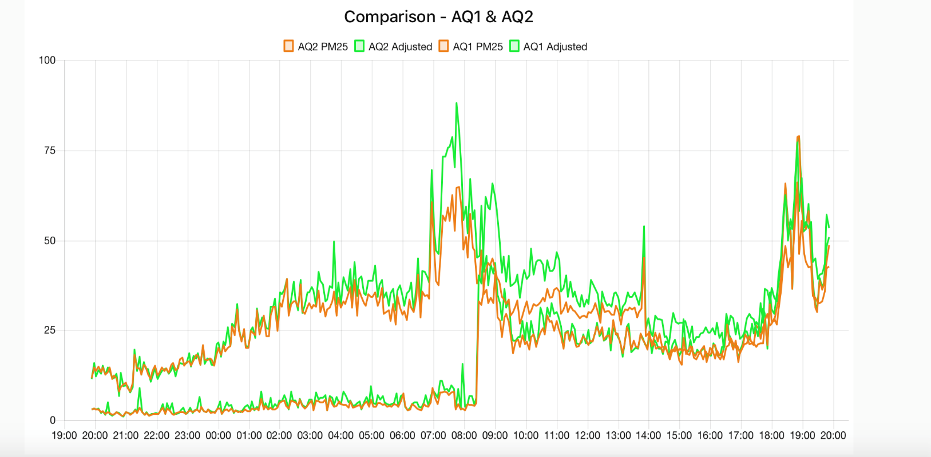
Data tells a story
We’ve found that once we get some readings we learn a little bit and then we have a lot more questions…

Slide 104












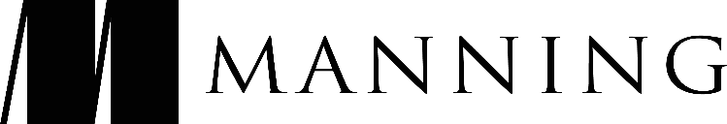
Sponsors
Notes:
Thank them
Microsoft – venue, catering
Black Marble – organisation/volunteers
iO Associates – Platinum Sponsors
DevExpress – speaker/volunteer shirts
Grey Matter – Gold sponsors
NDC, Landmark information, Sonoco Trident – Silver Sponsors
Global Data Sentinel – Agendas!
RevDeBug, Manning, Redgate – Bronze Sponsors

